Slide 1
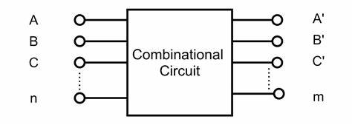
Combinational circuit
Combinational circuits are specially designed using multiple interconnected logic gates such that the output will be generated by computing the logical combinations of the present input only. No clock pulse is present here. Moreover, no previously stored value or state is taken into consideration here. The output is independent of previous states.
Example : Half/Full Adder, Half/Full Subtractor, Encoder/Decoder ,Multiplexer / Demultiplexer , etc .

Slide 2
Design Procedure of Combinational circuit
Find the required number of inputs and outputs and assign a symbol to each.
Derive the truth table according to given specifications and function.
Using the truth table, obtain simplified Boolean functions for each output as a function of the input variables.
Draw the logic circuit diagram.

Slide 3
Design a combinational circuit that has four input and two outputs. One of the outputs is high when majority of inputs are high . The second output is high only when all inputs are of same type.
HW: Advantage ,Disadvantage and application of Combinational circuits?

Slide 4
Half adder
The half adder is a basic building block for more complex adder circuits such as full adders and multiple-bit adders. It performs binary addition of two single-bit inputs, A and B, and provides two outputs, SUM and CARRY.
Truth table:
INPUTS |  | OUTPUTS
A | B | Sum(S) | Carry (C)
0 | 0 | 0 | 0
0 | 1 | 1 | 0
1 | 0 | 1 | 0
1 | 1 | 0 | 1

Slide 5
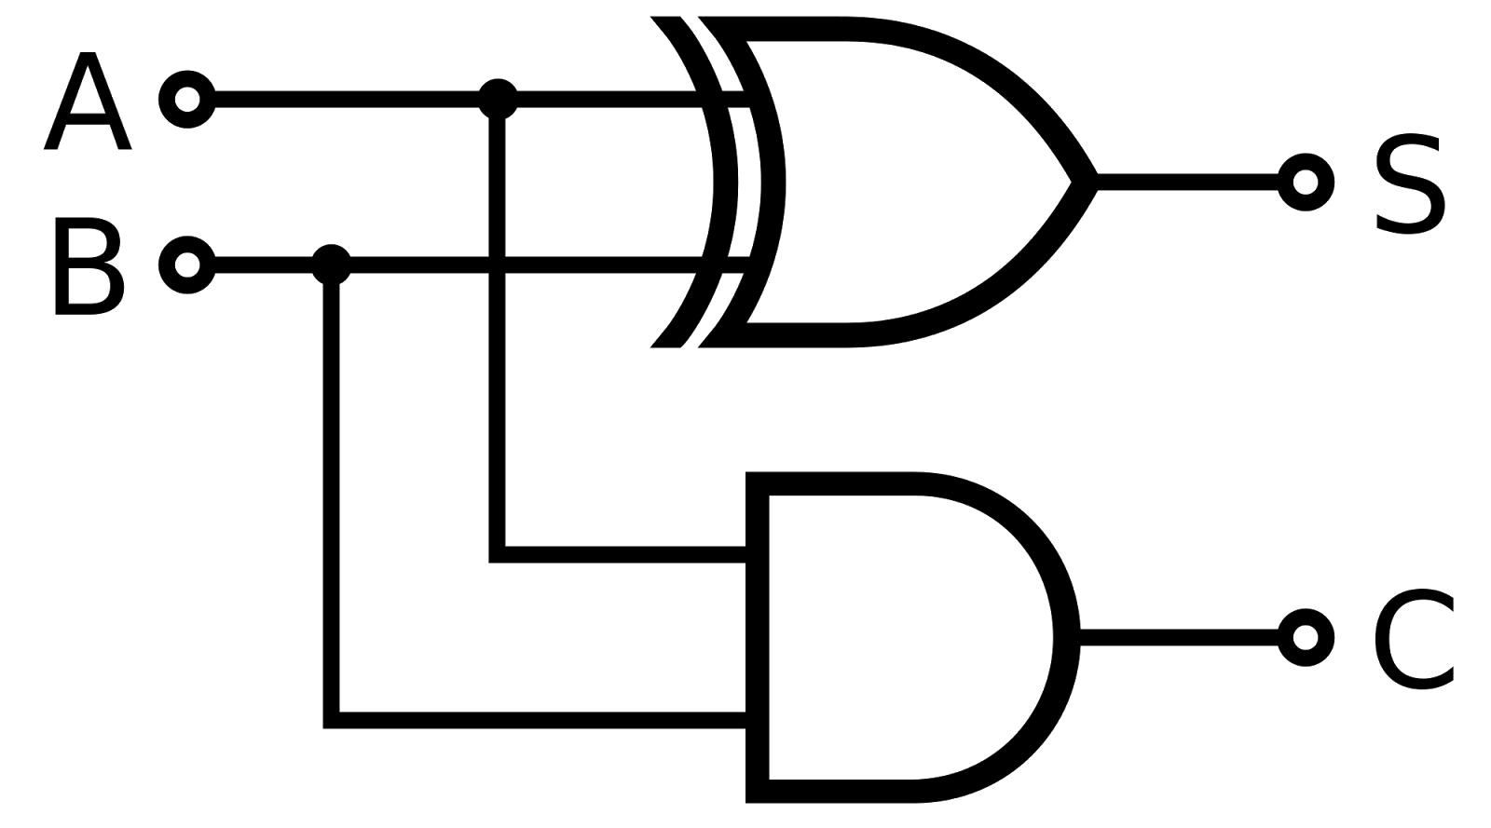
Circuit diagram

Slide 6
Full Adder
Full Adder is the adder that adds three inputs and produces two outputs. The first two inputs are A and B and the third input is an input carry as C-IN. The output carry is designated as C-OUT and the normal output is designated as S which is SUM.

Slide 7
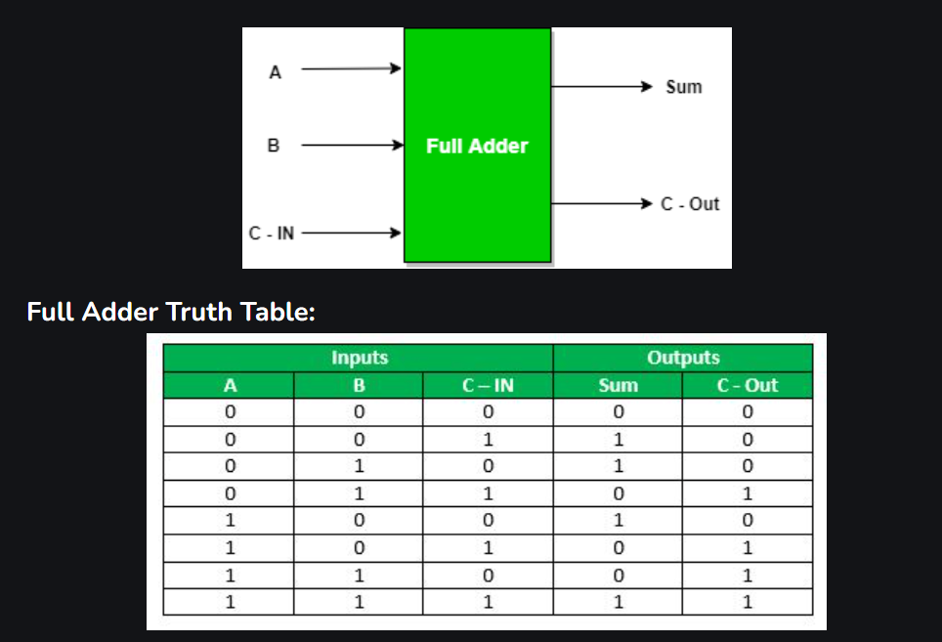

Slide 8
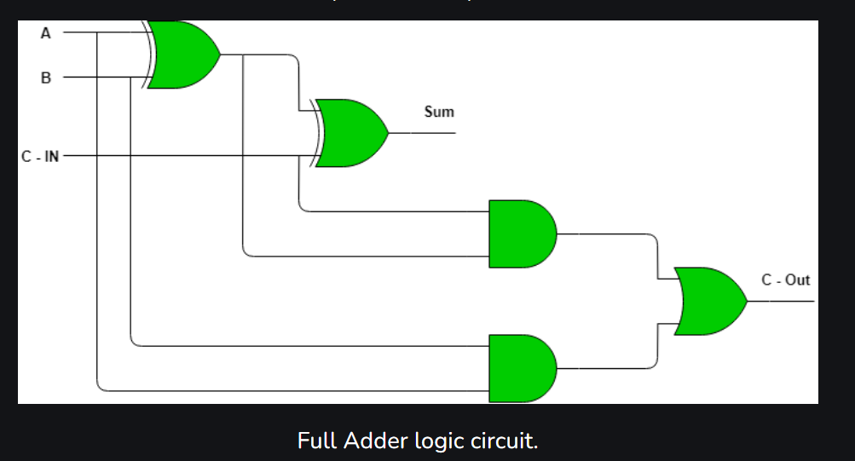

Slide 9
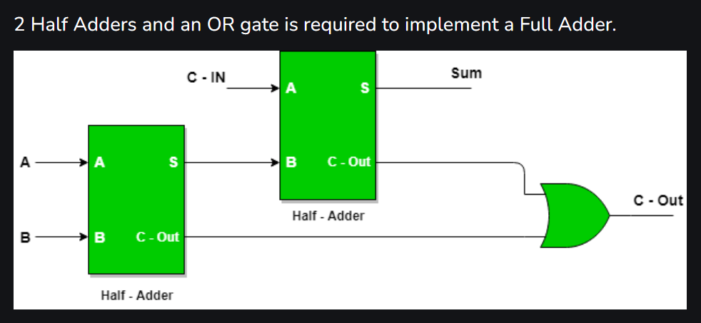
Implementation of Full Adder using Half Adders

Slide 10
HW
Implementation of Full and Half adder using NAND gates and NOR gates.
Advantage ,Disadvantage and application of Half adder and Full adder.

Slide 11
Half Subtractor
Half subtractor is a combination circuit with two inputs and two outputs that are different and borrow. It produces the difference between the two binary bits at the input and also produces an output (Borrow) to indicate if a 1 has been borrowed. In the subtraction (A-B), A is called a Minuend bit and B is called a Subtrahend bit.

Slide 12
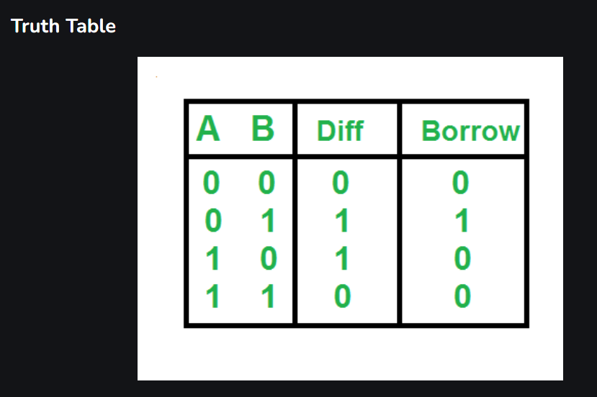
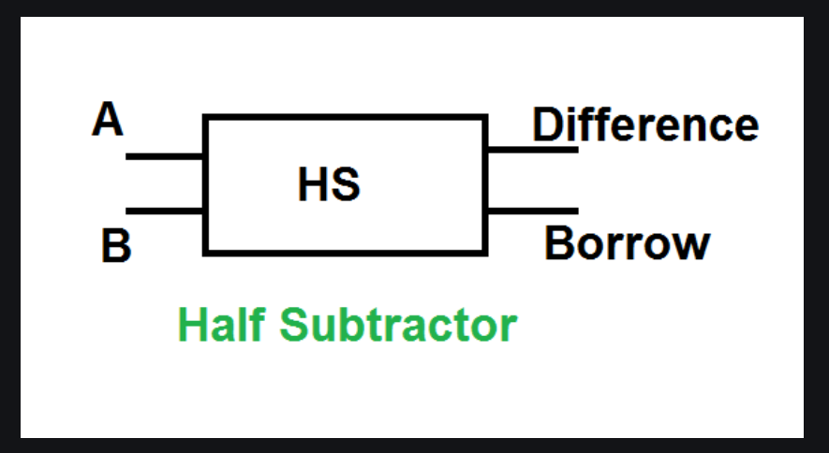

Slide 13
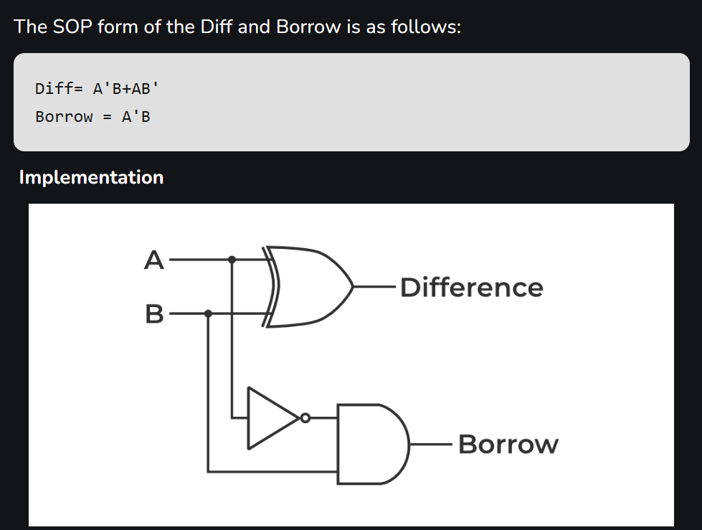

Slide 14
Full Subtractor
A full subtractor is a combinational circuit that performs subtraction of two bits, one is minuend and other is subtrahend, taking into account borrow of the previous adjacent lower minuend bit. This circuit has three inputs and two outputs. The three inputs A, B and Bin, denote the minuend, subtrahend, and previous borrow, respectively. The two outputs, D and Bout represent the difference and output borrow.

Slide 15
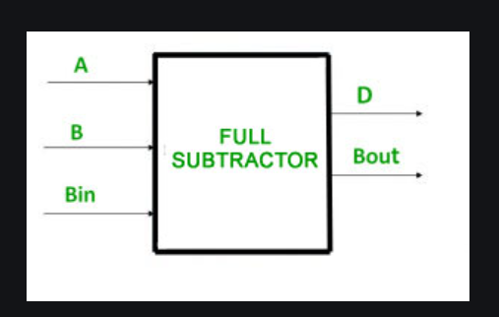
Full Subtractor

Slide 16
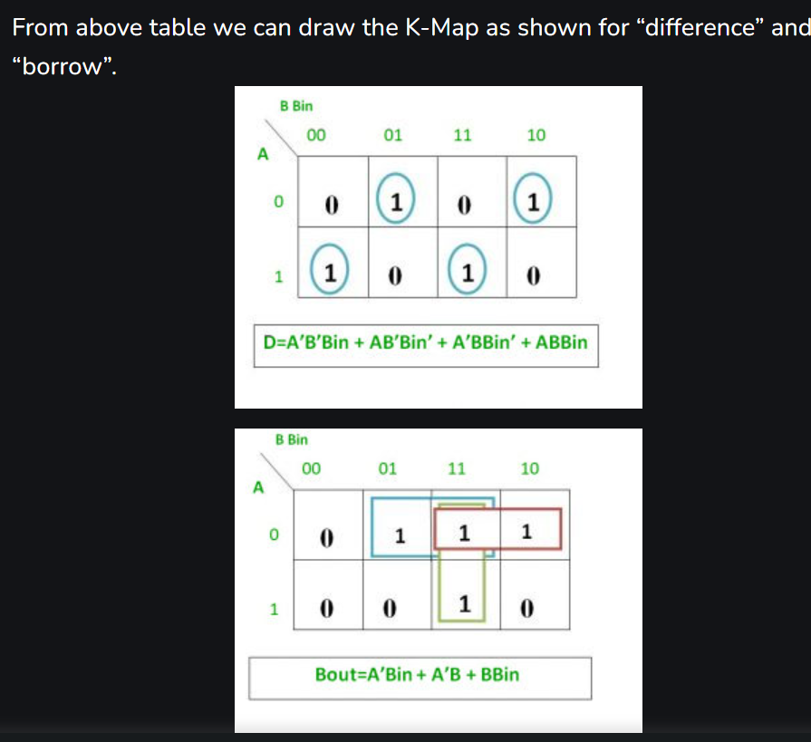
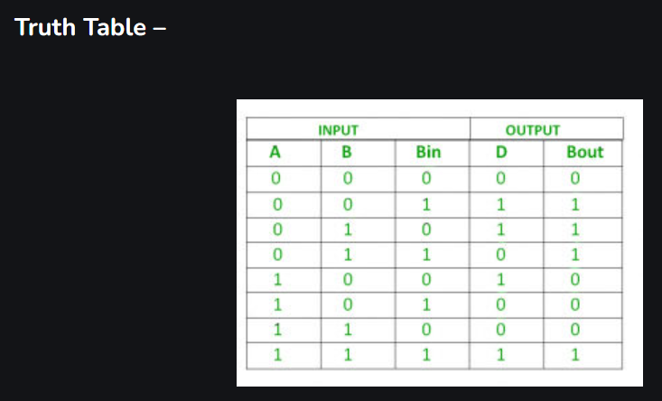
Full Subtractor

Slide 17
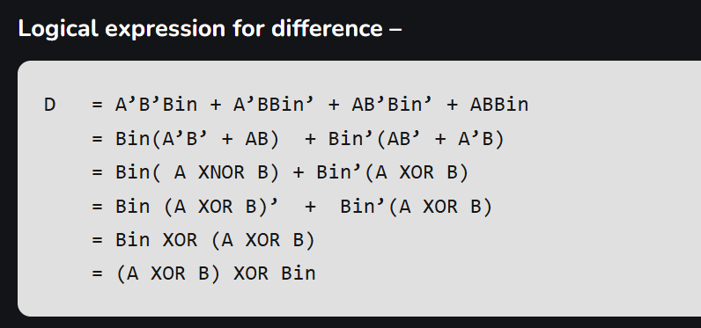
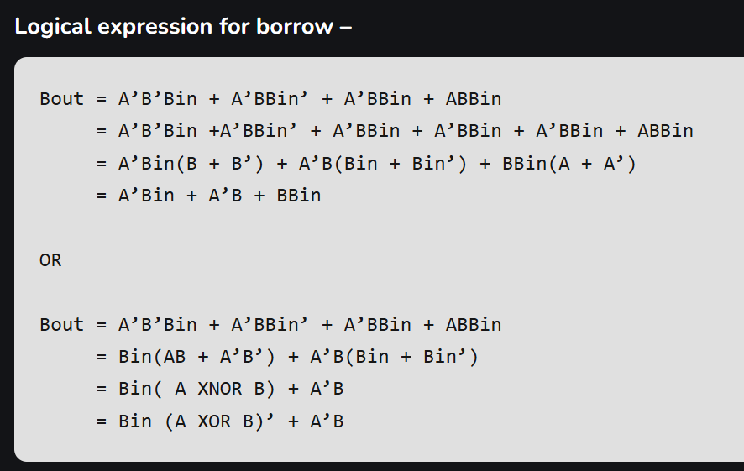
Full Subtractor

Slide 18
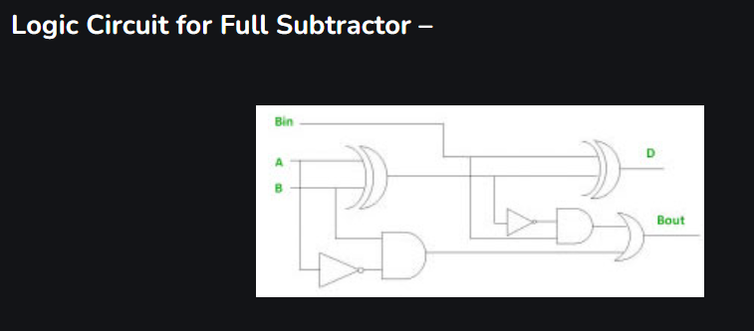
Full Subtractor

Slide 19
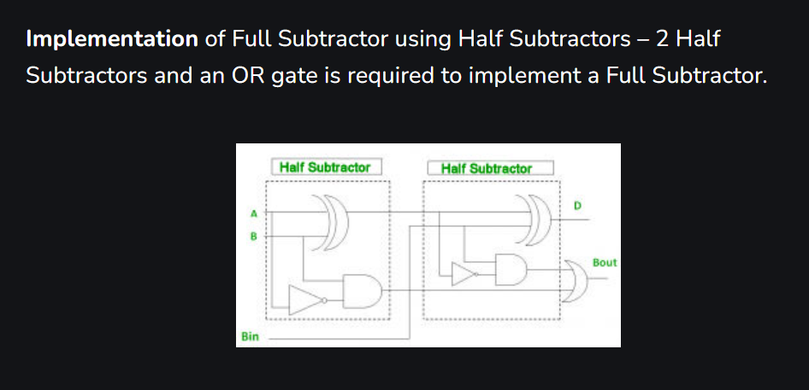
Full Subtractor

Slide 20
HW
Advantage , Disadvantage and Application of Half subtractor and full subtractor.
Full Subtractor using NAND gates and NOR gates only.

